Slide 1
Effective Teamwork and Teambuilding
Dr. Brandi Frisby

Slide 2
What do employers want?
1. Ability to work in a team structure
2. Ability to make decisions and solve problems
3. Ability to communicate verbally with people inside and outside an organization
4. Ability to plan, organize and prioritize work
5. Ability to obtain and process information
6. Ability to analyze quantitative data
7. Technical knowledge related to the job
8. Proficiency with computer software programs
9. Ability to create and/or edit written reports
10. Ability to sell and influence others
Adams, 2015
Forbes

Slide 3
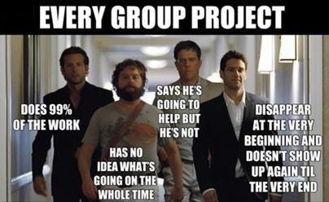
In your groups: What bothers you most about team work? What are the advantages to team work?
Notes:
“venting” session – compile a list of common complaints about groupwork
Grouphate scale?
BRANDI

Slide 4
Team Challenge – Car Pool

Slide 5
Discussion
Was your team successful? Why or why not?
What were the biggest challenges?
Did a leader emerge? Were they effective leaders?
Did any of your pet peeves show up? How did you handle it?
Was there any conflict? Stress? How did you manage it?
How would this activity have gone if you had to complete it by yourself?

Slide 6
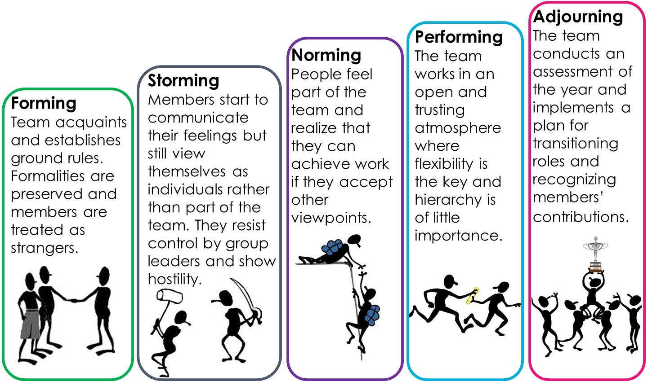
Tuckman’s Model of Group Development
Group
Development
Example

Slide 7
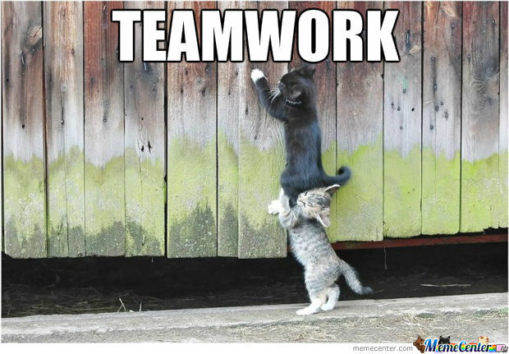
Characteristics of Effective Teams
Interdependent (≠ “divide and conquer”)
Cohesive (teambuilding to build trust and rapport)
Productive Norms (behavioral expectations)
Accountable (responsible for adhering to norms)
Synergy
Notes:
This is an example of content you may teach your students about what makes a group “healthy)
AMY

Slide 8
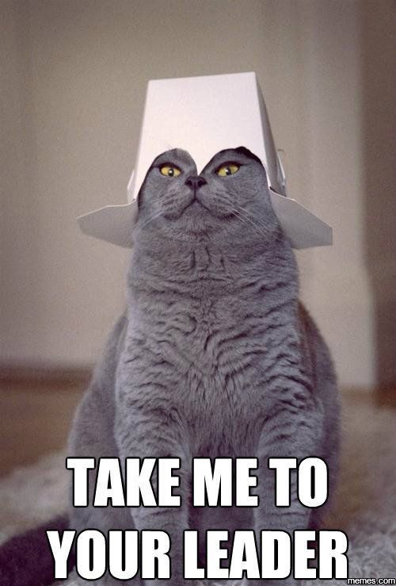
Leadership
Write down your top 5
characteristics of good leaders.
Now, write down the top 5 characteristics of a
good communicator in the workplace.
Communication
Leadership

Slide 9
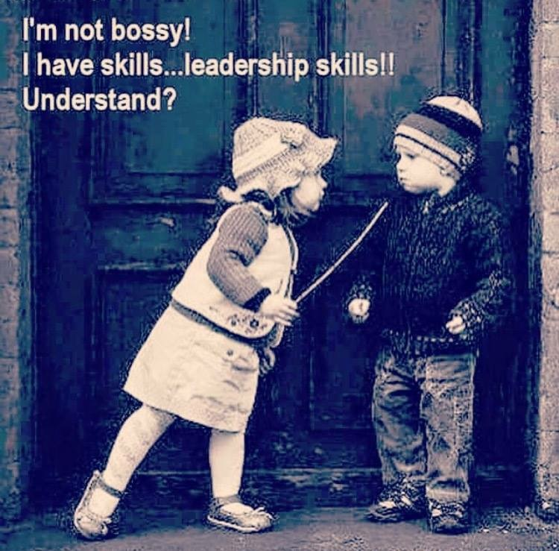
Group Roles - Leadership
Informal/emergent leaders vs. formal leaders
Shared leadership is most effective
Shared leadership occurs when all roles
work together to reach common goal
Delegate tasks, play to each member’s
strengths

Slide 10
Other Group Roles
Task roles- help group complete a task
E.g., information givers, analyzers, seekers
Maintenance Roles- help a group maintain and develop cohesion
E.g., supporters, harmonizers, mediators
Procedural Roles- directly support group process
E.g., logistics, expediters, gatekeepers

Slide 12
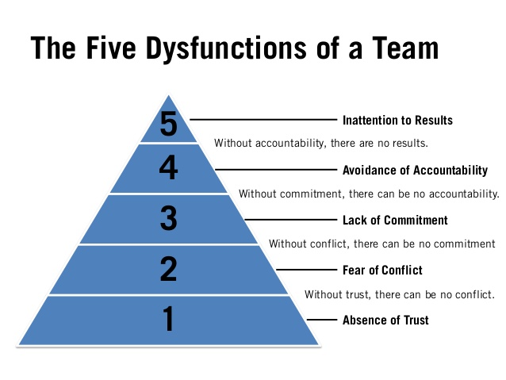
Group Conflict: Causes
Differing goals
Differing ways of achieving goals
Differing interpersonal needs
Differing expectations of behavior

Slide 13
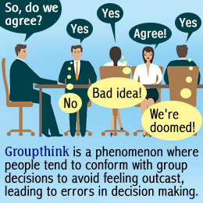
Tips for Solving Team Conflict
Understand that conflict is normal…beneficial
Use “I” Language
Empathize
Perception Check
Keep your eye on the prize
Rational, not emotional
Set rules for behavior and stick to them
Active listening
Compromise and collaborate
Groupthink at NASA

Slide 14
Take Away Messages
Professors AND Employers want team work
Allow a group to form – get involved to shape that formation
Formal and Informal Norms
Every person has an important role. All roles → synergy
Conflict is NOT bad; conflict management CAN be bad

